Slide 1
Final Report of Data Science Project
Wentian Wang

Slide 2
Problem Definition
If someone want to open a general restaurant in the Manhattan, which neighbourhood is the best choise for him?

Slide 3
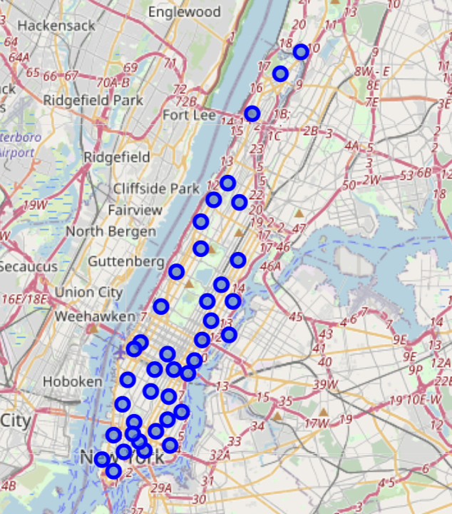
Map Ploting

Slide 4
Data Selection
The data contains the neibourhood's location data and the venue data. The location data is download from IBM developer skill learning website the location is from http://cocl.us/Geospatial_data. The venue data is request from the foursquare.

Slide 5
First Level Data
Neighbourhood | Borough | Latitude | Longitude
Marble Hill | Manhattan | 40.876551 | -73.910660
Chinatown | Manhattan | 40.715618 | -73.994279
Washington Heights | Manhattan | 40.851903 | -73.936900
Inwood | Manhattan | 40.867684 | -73.921210
Hamilton Heights | Manhattan | 40.823604 | -73.949688

Slide 6
Second Level Data
Neighborhood | Neighborhood Latitude | Neighborhood Longitude | Venue | Venue Latitude | Venue Longitude | Venue Category | id
Marble Hill | 40.876551 | -73.91066 | Arturo's | 40.874412 | -73.910271 | Pizza Place | 4b4429abf964a52037f225e3
Marble Hill | 40.876551 | -73.91066 | Tibbett Diner | 40.880404 | -73.908937 | Diner | 4b79cc46f964a520c5122fe3
Marble Hill | 40.876551 | -73.91066 | Dunkin' | 40.877136 | -73.906666 | Donut Shop | 4b5357adf964a520319827e3
Marble Hill | 40.876551 | -73.91066 | Land & Sea Restaurant | 40.877885 | -73.905873 | Seafood Restaurant | 4b9c9c6af964a520b27236e3
Marble Hill | 40.876551 | -73.91066 | Subway | 40.874667 | -73.909586 | Sandwich Place | 4b4f7b65f964a5205a0827e3

Slide 7
Third Level Data
 | Neighborhood | Neighborhood Latitude | Neighborhood Longitude | Venue | Venue Latitude | Venue Longitude | Venue Category | id
0 | Marble Hill | 40.876551 | -73.910660 | Arturo's | 40.874412 | -73.910271 | Pizza Place | 4b4429abf964a52037f225e3
1 | Marble Hill | 40.876551 | -73.910660 | Bikram Yoga | 40.876844 | -73.906204 | Yoga Studio | 4baf59e8f964a520a6f93be3
2 | Marble Hill | 40.876551 | -73.910660 | Tibbett Diner | 40.880404 | -73.908937 | Diner | 4b79cc46f964a520c5122fe3
3 | Marble Hill | 40.876551 | -73.910660 | Dunkin' | 40.877136 | -73.906666 | Donut Shop | 4b5357adf964a520319827e3
4 | Marble Hill | 40.876551 | -73.910660 | Astral Fitness & Wellness Center | 40.876705 | -73.906372 | Gym | 4cf6ae55d3a8a1cd71a9d243

Slide 8
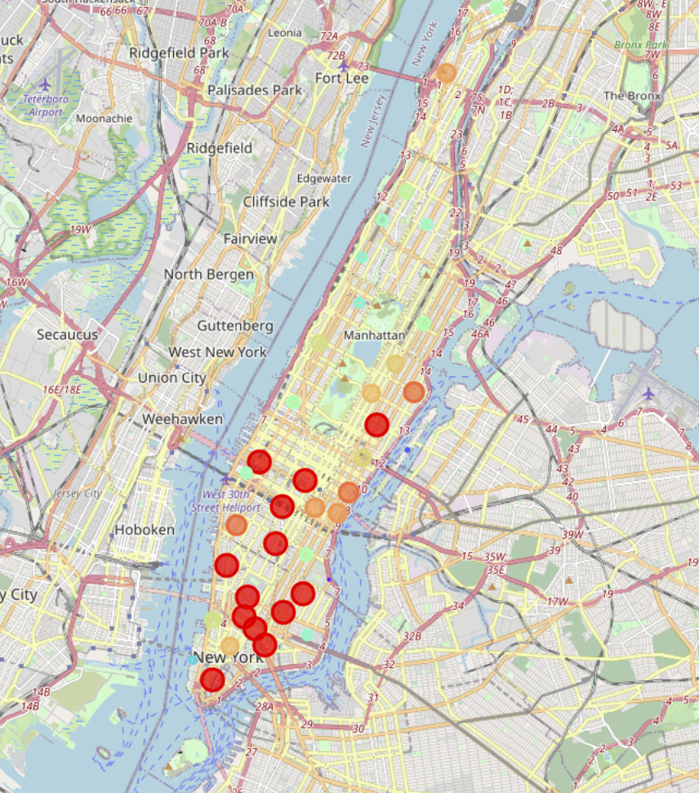
Food Venue Numbers

Slide 9
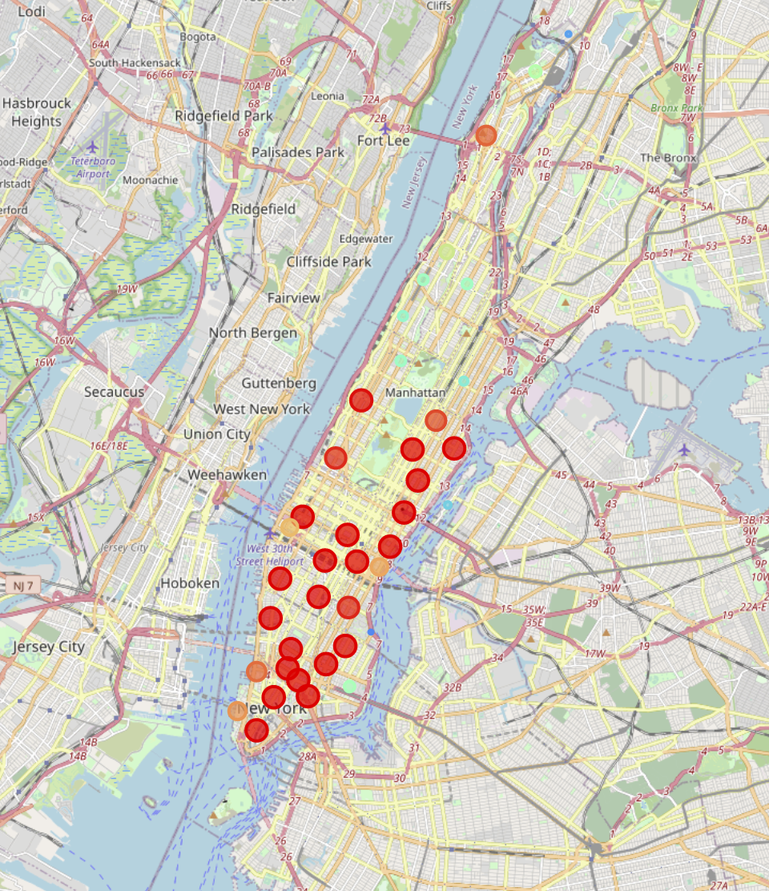
Total Venue Numbers

Slide 10
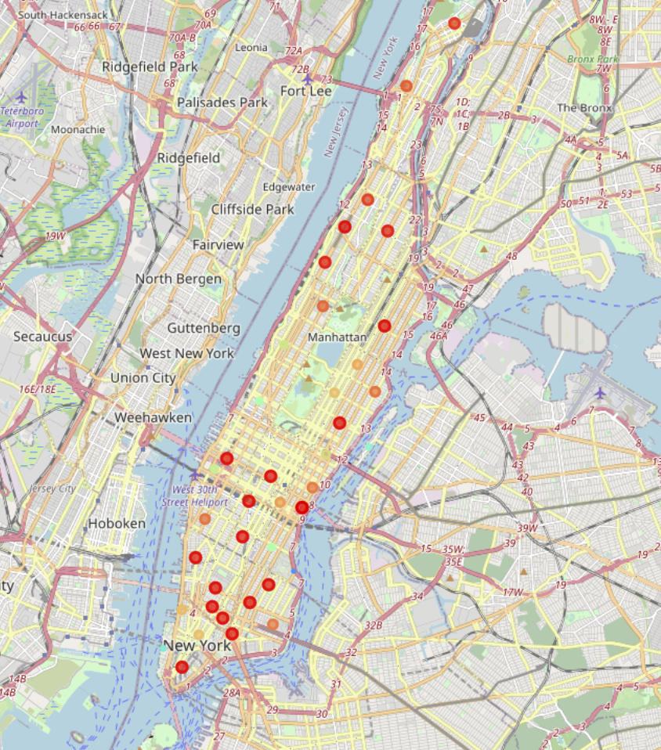
Food Venue Portion

Slide 11
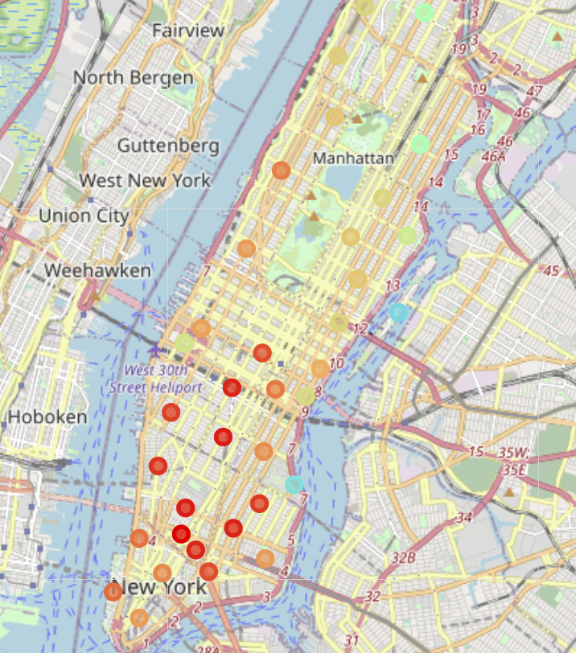
Average Like Number in Each Food Venue

Slide 12
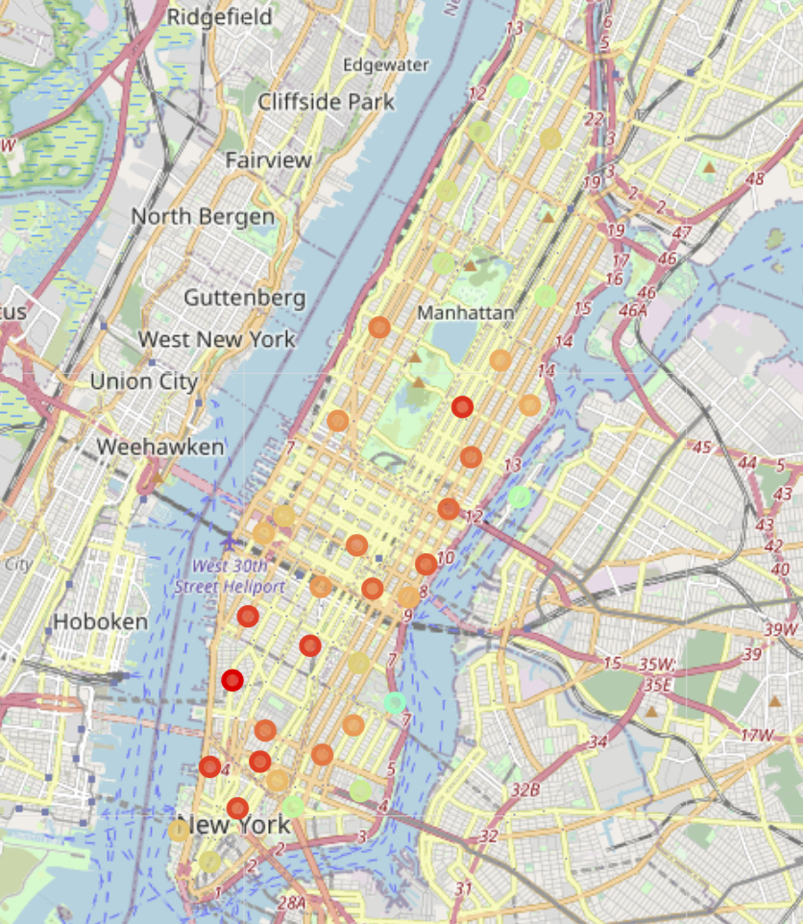
Average Price Level in Each Food Venue

Slide 13
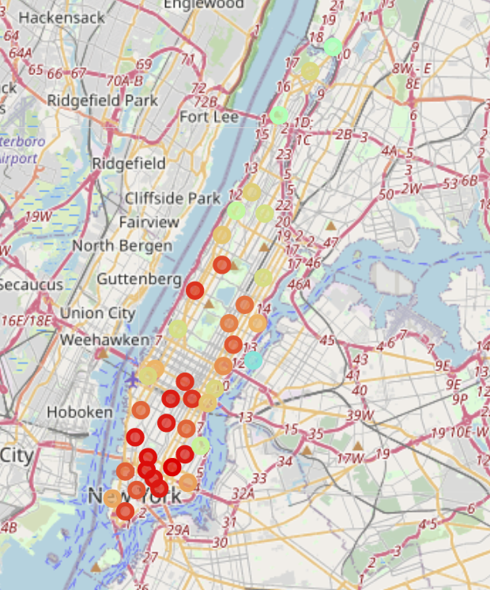
Average Rating Number in Each Food Venue

Slide 14
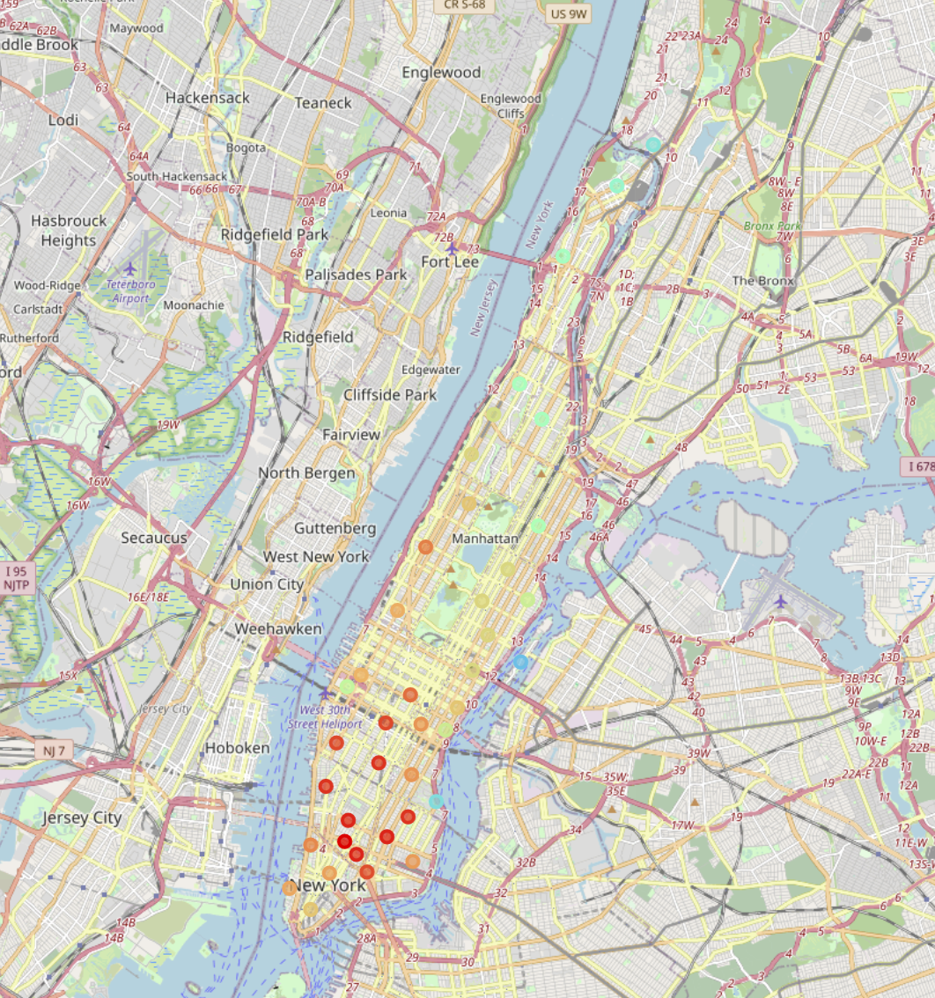
Average Tip Number in Each Food Venue

Slide 15
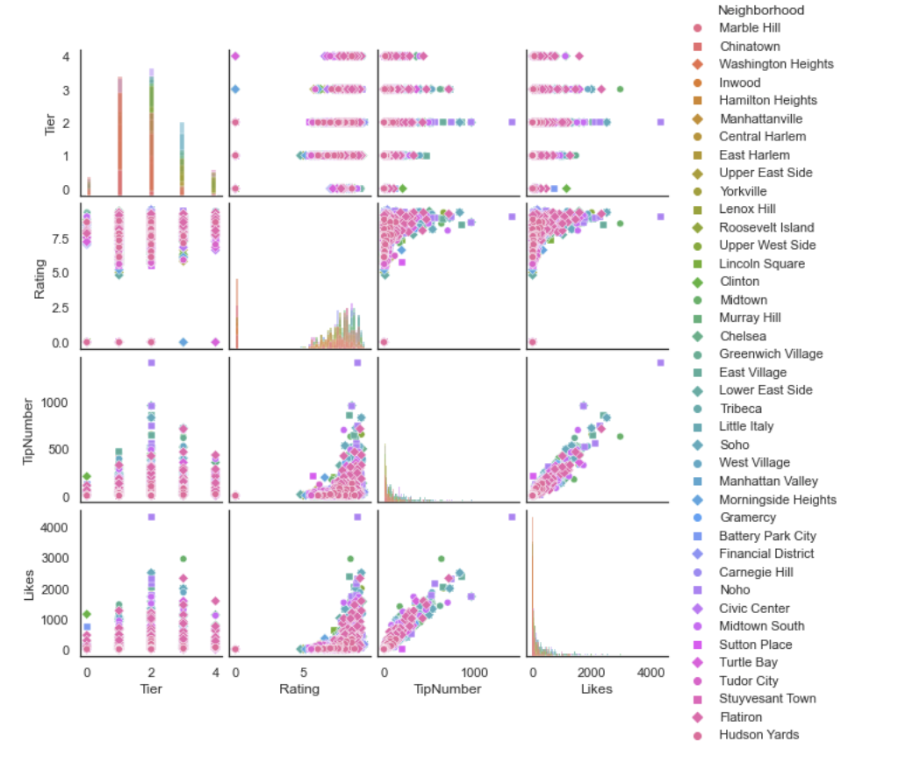
Correlation Plot for Each Food Venue

Slide 16
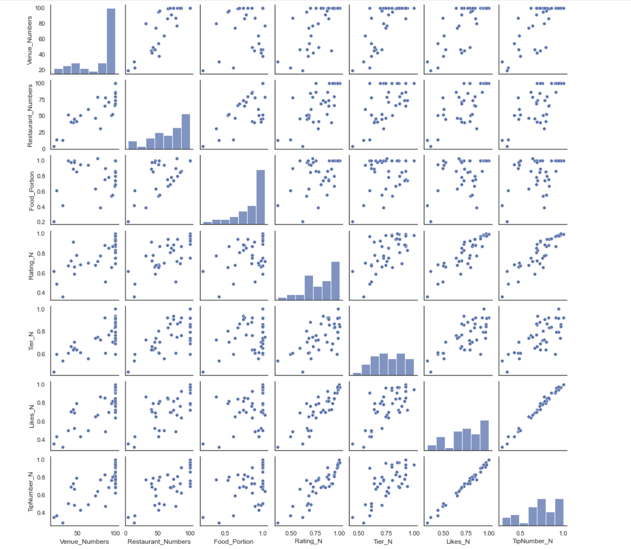
Correlation Plot for Each Neighbourhood

Slide 17
First Model
$$Q=(k1*Food_protion+k2*Rating_{N}+k3*Tier_{N}+k4*TipNumber_{N}+k5*Likes_{N})/(k1+k2+k3+k4+k5)$$
Neighborhood | Q
Soho | 0.976926
West Village | 0.974078
Flatiron | 0.955280
Greenwich Village | 0.945727
Noho | 0.941565
East Village | 0.912479
Midtown South | 0.910387
Chelsea | 0.904635
Little Italy | 0.904100
Midtown | 0.896390
Tribeca | 0.865752
Murray Hill | 0.861832
Civic Center | 0.845576
Upper West Side | 0.840344
Chinatown | 0.835970
Lenox Hill | 0.820822
Upper East Side | 0.806590
Financial District | 0.797310
Turtle Bay | 0.789250
Neighborhood | Q
Clinton | 0.776129
Sutton Place | 0.768154
Gramercy | 0.765916
Carnegie Hill | 0.757348
Manhattan Valley | 0.755399
Lower East Side | 0.752240
Battery Park City | 0.739471
Lincoln Square | 0.739051
Tudor City | 0.734696
Morningside Heights | 0.721362
Yorkville | 0.719537
Manhattanville | 0.685324
Hudson Yards | 0.671361
Central Harlem | 0.642896
East Harlem | 0.618891
Hamilton Heights | 0.600596
Inwood | 0.589793
Washington Heights | 0.568616
Marble Hill | 0.498252
Stuyvesant Town | 0.417852
Roosevelt Island | 0.398327

Slide 18
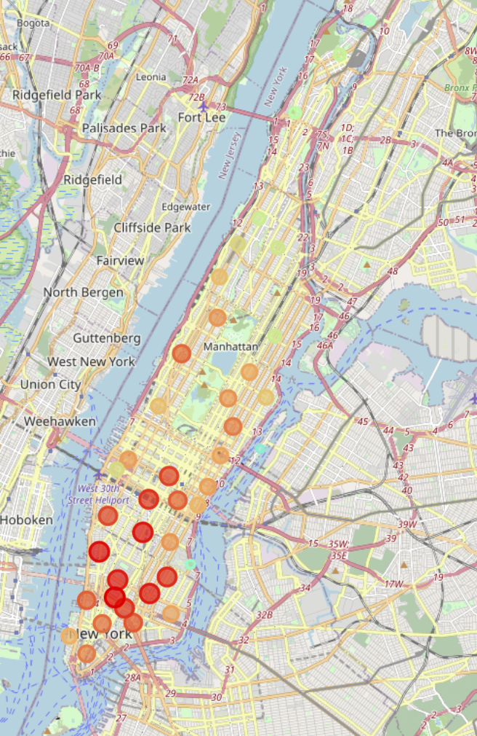
First Model Result Plot

Slide 19
Second Model
$$Q=(Food_protion×Rating_{N}×Tier_{N}×(TipNumber_{N}+Likes)/2)$$
Neighborhood | Q
West Village | 0.928157
Soho | 0.922302
Flatiron | 0.863710
Greenwich Village | 0.832922
Noho | 0.820061
East Village | 0.739700
Midtown South | 0.732098
Midtown | 0.707035
Little Italy | 0.701354
Chelsea | 0.636509
Murray Hill | 0.545949
Lenox Hill | 0.545829
Chinatown | 0.526744
Tribeca | 0.519175
Financial District | 0.487730
Civic Center | 0.480643
Upper West Side | 0.439491
Clinton | 0.420608
Upper East Side | 0.410965
Neighborhood | Q
Turtle Bay | 0.392789
Manhattan Valley | 0.379397
Tudor City | 0.364865
Carnegie Hill | 0.356320
Lower East Side | 0.341767
Sutton Place | 0.335674
Morningside Heights | 0.328933
Yorkville | 0.314418
Gramercy | 0.275708
Manhattanville | 0.261593
Central Harlem | 0.229644
Lincoln Square | 0.222424
East Harlem | 0.207149
Hudson Yards | 0.199839
Hamilton Heights | 0.182828
Battery Park City | 0.178840
Inwood | 0.173147
Washington Heights | 0.135977
Marble Hill | 0.071456
Roosevelt Island | 0.024966
Stuyvesant Town | 0.020213

Slide 20
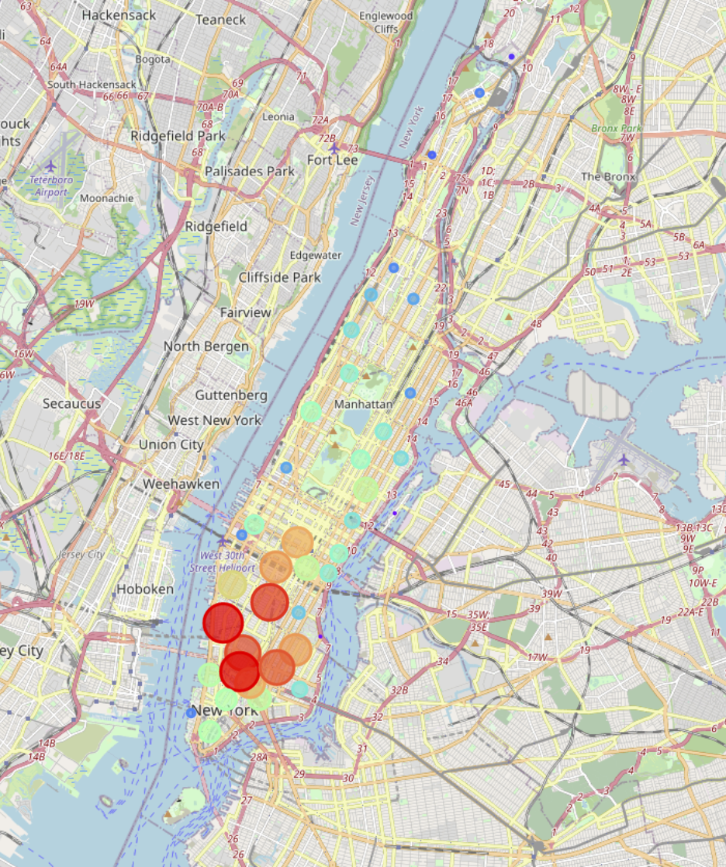
Second Model Result Plot

Slide 21
Conclusion
The first model think that the Soho is the best neighbourhood to open. The second model think the West Village is the best choice
The second model is more conservative comparing to the first model
If one want to minimize the risk of failure, the West Village would be the first selection

